Slide 1


NestJS
Building server-side apps and services in Typescript
Notes:
Start: Thank Galen and Justin and talk about how great RVAJS is. Gauge audience backend experience

Slide 2
NestJS: THE ELEVATOR PITCH
What is NestJS and why should you use it?
NestJS is a server side framework. It helps you quickly bootstrap a feature rich application server with best practices
It is easily extensible and comes with prebuilt modules for many scenarios common to backend development
Angular inspired syntax makes it easy to transfer concepts
It provides a CLI tool for quickly creating controllers, services, resolvers, and many more
Typescript, DI, Modular Architecture, Testability, Logging
OSS released in late 2016
Notes:
Spend time on “server side framework”
Speed thru rest
Explain licensing and…

Slide 3

It was made by this guy… Kamil Mysliwiec
Notes:
Intro the author

Slide 4

I don’t know much about him… Look! Puppies!
Notes:
This is one of the cons of using NestJS. It is not supported or financially backed by any large org. If you are an enterprise user who requires LTS versions… He has been loosely associated with Google during the dev of NestJS, but it is not a Google backed project.

Slide 5
Did you say MODULES?
Redis
GraphQL
RabbitMQ
Type ORM
gRPC
Mongoose
Caching
Validation
Logging
WebSockets
Swagger
Health Checks
MikroORM
Sequelize
Prisma
Kafka
OpenAPI
Passport
Encryption and Hashing
Security
Routing
NATS
JamStack / Static apps
Notes:
Spend some time here – With each class of add-ons, ask who uses it already. Dwell on the popular ones. Get excited about the obscure ones.

Slide 6

Notes:
Summation: Part of the reason why NestJS is so powerful is that it already has 90% of a BE workflow OOB.

Slide 7

Benefits
Opinionated Framework:
NestJS projects have a predefined structure providing best practices for testability, scalability and maintainability.
Typescript:
NestJS leverages Typescript and gains all of its related benefits out of the box.
Jest:
A well configured Jest testing setup. Test files are generated for developers and feedback is immediate and useful.
Abstracted API:
NestJS retains common patterns in backend development while abstracting the nuts and bolts. This allows it to be agnostic to the underlying transport. Currently they support Express and Fastify.

Slide 8
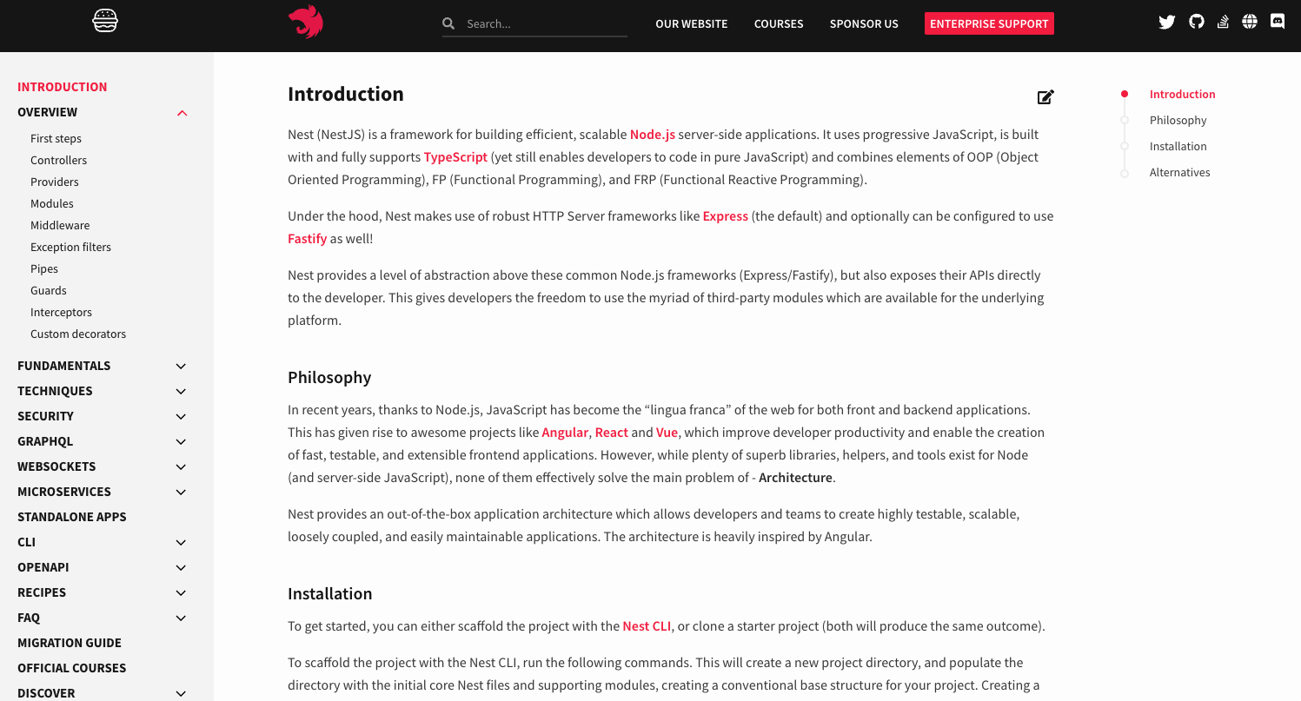
Well Documented (NestJS.com)

Slide 9

Core Concepts
A few basics before we dive in

Slide 10
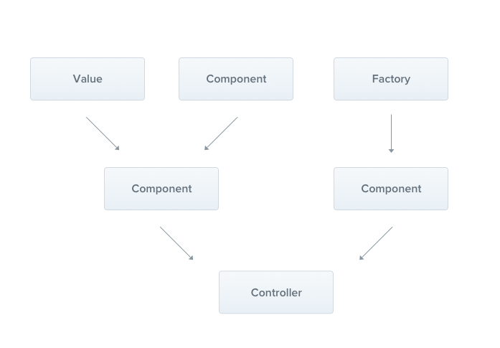
Controllers/Resolvers and Providers
Controllers are responsible for handling incoming requests and returning responses to the client.
Providers make up many of the basic NestJS classes - services, repositories, factories, helpers, and so on.
The main idea of a provider is that it can be injected as a dependency; this means objects can create various relationships with each other, and the function of "wiring up" instances of objects can largely be delegated to the Nest runtime system.
Notes:
This is familiar to Angular developers and forms the core of good SOLID engineering principles.

Slide 11
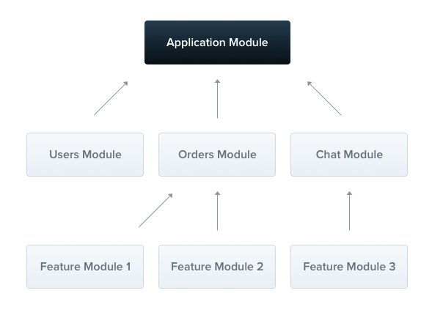
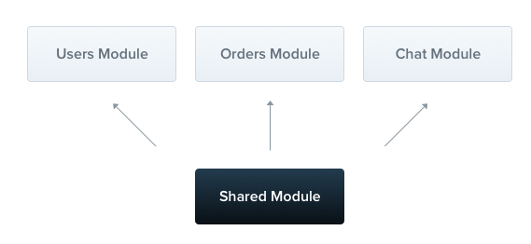
Modules
Modules help us organize our application structure and take a lot of the heavy lifting out of Dependency Injection.
By Default, modules are singletons. This means that a single module instance can be used in multiple services.

Slide 12
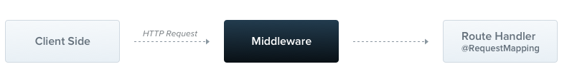
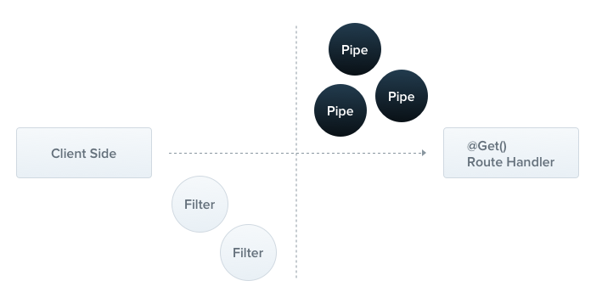
Middleware
Pipes and Filters
Middleware are functions which are called before the route handler.
Pipes are useful for validation and data type conversion (i.e. string to int)
Exception filters handle errors automagically
Notes:
Middleware is a function which is called before the route handler.
Pipes are useful for validation and data type conversion (i.e. string to int)
Exception filters handle errors automagically

Slide 13
Decorators
@Request(), @Req() | req
@Response(), @Res() | res
@Next() | next
@Session() | req.session
@Param(param?: string) | req.params / req.params[param]
@Body(param?: string) | req.body / req.body[param]
@Query(param?: string) | req.query / req.query[param]
@Headers(param?: string) | req.headers / req.headers[param]
@Ip() | req.ip
@HostParam() | req.hosts
An ES2016 decorator is an expression which returns a function and can take a target, name and property descriptor as arguments.
In Express, you might do
const user = req.user
to get the userId of the user making the request.
Nest uses decorators to accomplish the same thing while abstracting the implementation. You would use the @Req decorator and request the user.
@Req(‘user’) user: string

Slide 14
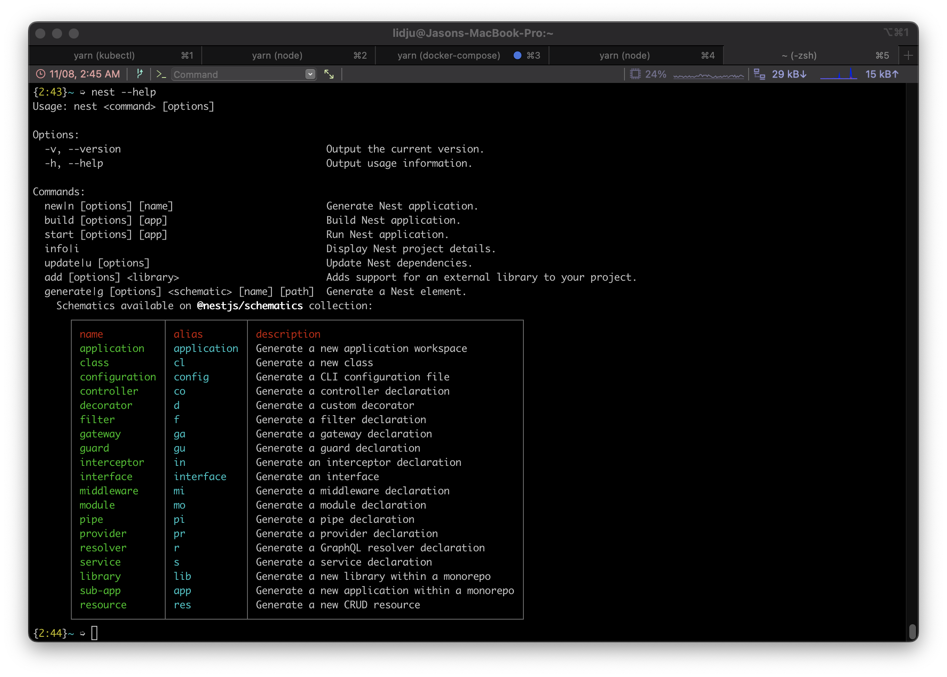
The Nest CLI

Slide 15

That’s all you need to know folks!
Let’s go write some code!

Slide 16

https://github.com/JasonMaggard/NestJS-RVAJS-2022
For the sample code used in this presentation:
Thank you for attending!

